Slide 1
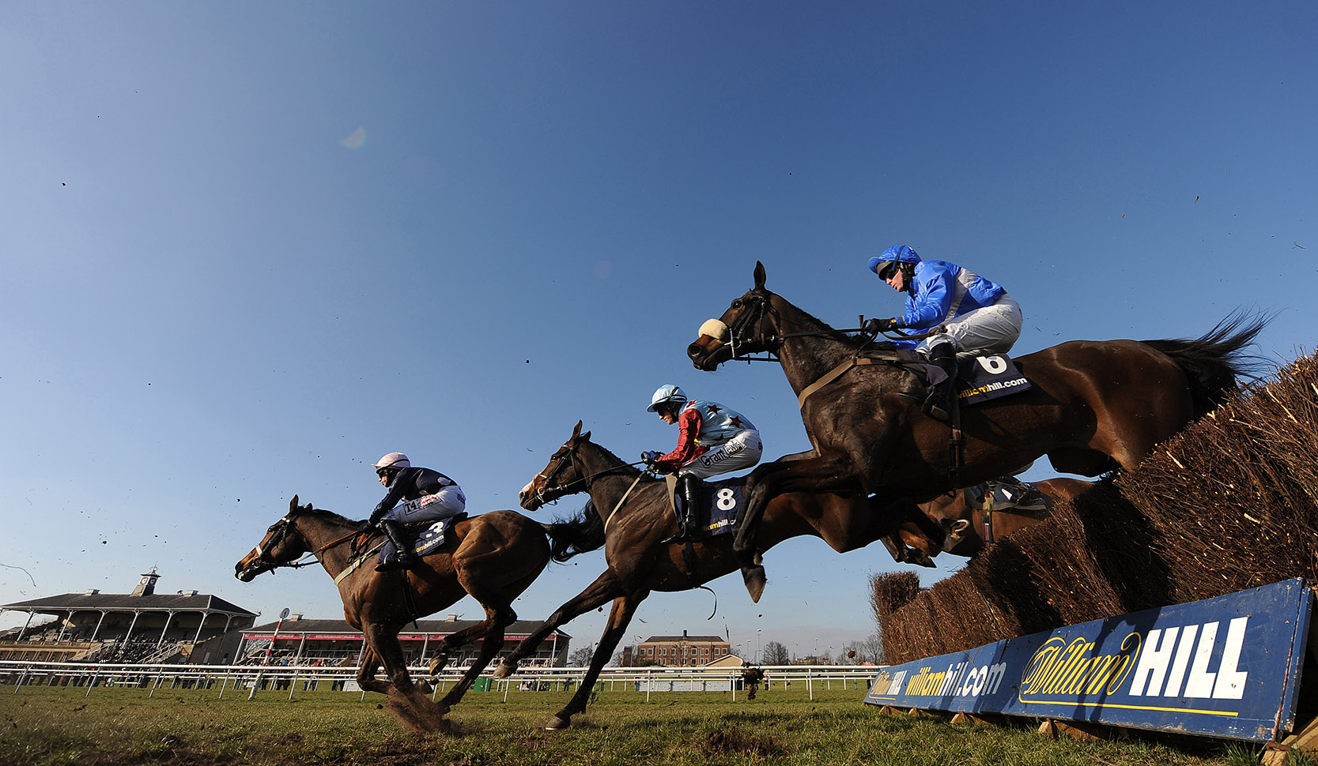
Set Up for Success
A Journey of Self Awareness and Support

Slide 2
Context:
Since the announcement of the new Gaming Model, a lot of investment has been made into the Portal Teams.
Now the leadership, the coaches and the management want to understand how best to support you.
We are running a series of self managed awareness workshops entitled
Set up for Success.

Slide 3
Checklist
In each workshop, explore the question and find the answers for you & your team.
By the last workshop we have only succeeded if you have answered each question!
Are we set up for success?
Do we understand the goal?
Health Check - how are things going & how are the players feeling?
Do we have the skills to deliver this? (Skills, people, relationships, support etc) what gaps do we have in knowledge?
Have we identified and mitigated risks and issues?
Is there a mechanism to review and raise risks in an effective manner?
Do we understand the timeline and key milestones (including external and legal dependencies)?
Is the business fully engaged?
Do we know who all the stakeholders are?
Do we have a comprehensive Comms strategy that is working?
Do we have a comprehensive and visual agreement for delivery (e.g. sprint goal roadmap etc)?

Slide 4
R&R Joint Workshop
Understanding our Norms, celebrating our differences
& Collaborating for Best Practice
Who | Duration | What
External SM | 1:55 | Roles And Responsibilities
SM Propose the blue items be run w/c 19th workshop as key members are not available this week

Slide 5
Team Workshop – One Per team
Collaboration, communication & understanding
Who | Duration | What | Why
Jon | 0:05 | Culture (Cheers V’s How’s you) | Ice breaker
Senior PO | 0:10 | Work Prioritisation | Deck from Lowrey to explain
Jon & James | 0:45 | Communications & Planning: Affinity Planning & Beyond
PM & SM | 0:30 | Stakeholders Engagement & Interaction (who, when & how often)
Scrum Master |  | Working Practices & Procedure
PM & SM |  | Collaboration | Skills, decisions & working agreements
PM & SM |  | Technical Decision Making | Timescales, processes & planning consultation
SM propose the blue items be run as a separate JOINT workshop;
but it will need to delay due to key people availability for R&R workshop.
Black items remain as team level – but facilitated by Agile Coach.

Slide 6
Tech Investment Workshop
Technical Investment in a world of uncertainty
Who | Duration | What | Why
TBC |  | Support of Technical Projects | Co-operative engagement Technical input at Start of project How do we support each sprint
TBC |  | Technical Architecture | Who are key players How do we do KT sharing skills between teams (Glen etc).
TBC |  | Technical Debt & Defects | How does it come into the team When is it ours and not payments, core etc.
TBC |  | Technical Investment (Debt)

